Slide 1

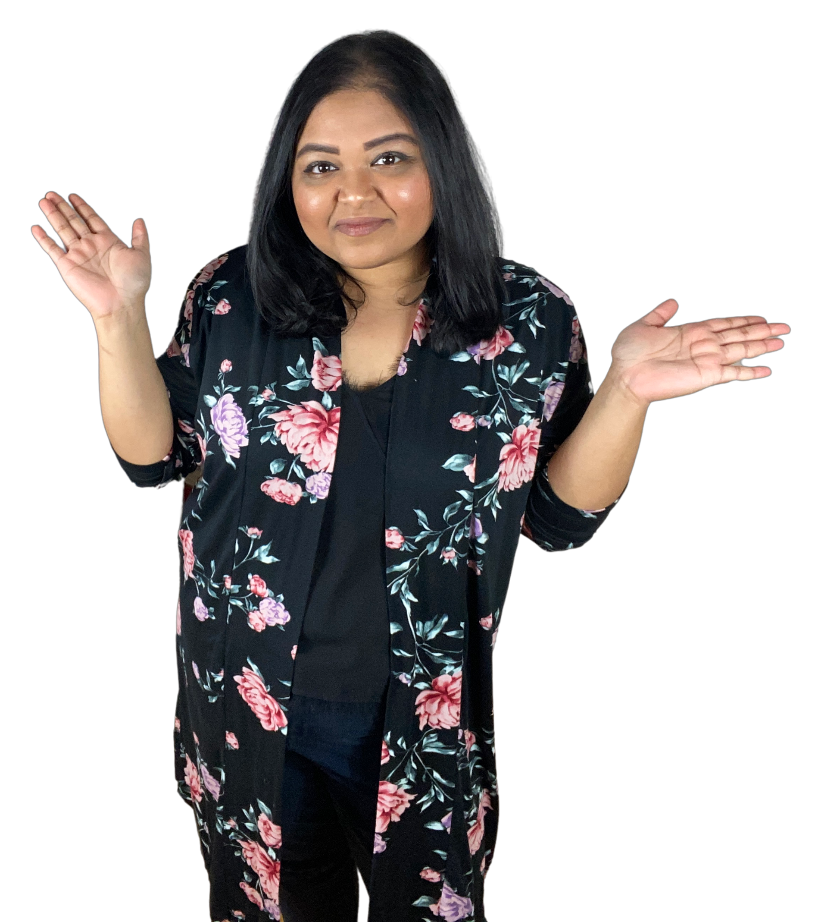
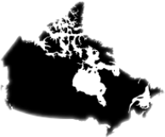
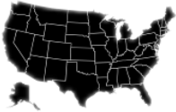


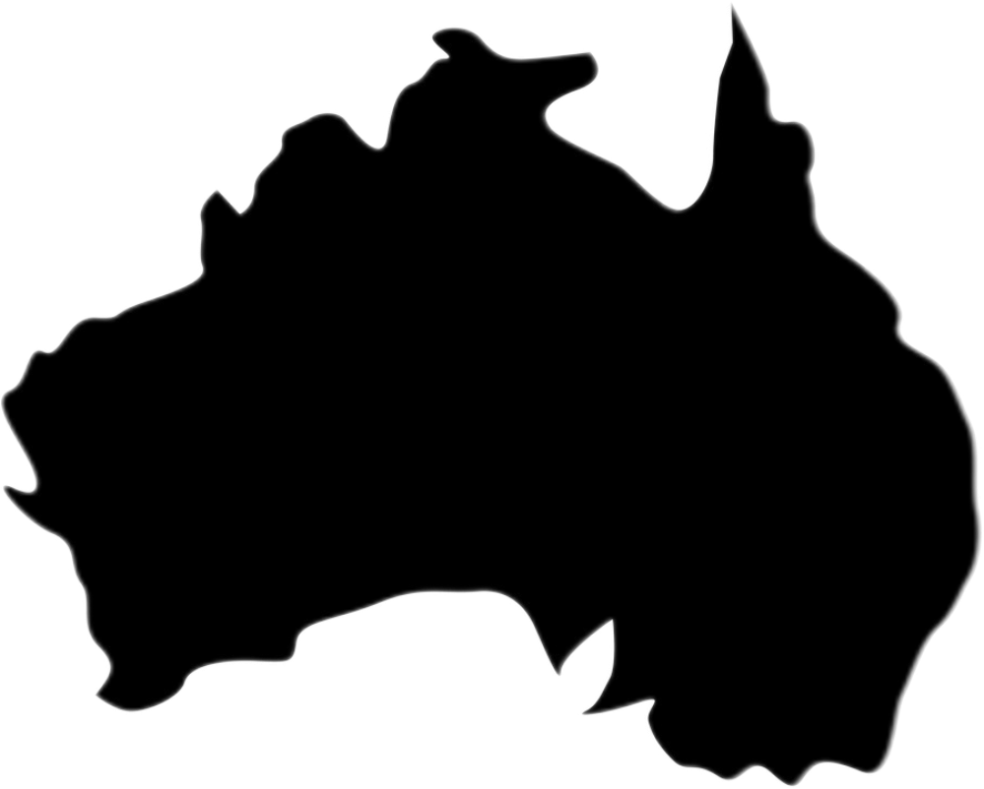











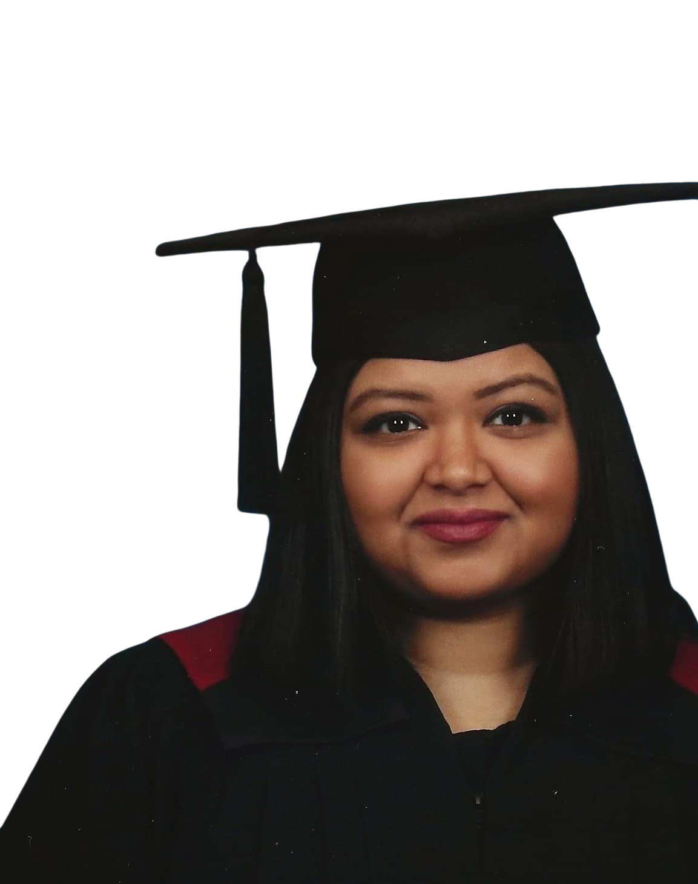
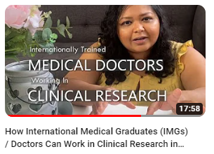
THE BROWN FEMINIST
Faria Ahmed, RN, MSc
www.thebrownfeministcanada.ca
www.stemstickrs.com
TOP 5 COUNTRIES
Canada
USA
India
UK
Australia
About Me
Clinical Research Professional
Registered Nurse
Career consultant
Content Creator
Seasoned Entrepreneur
Ottawa, Canada
DEMOGRAPHIC
69.8%
Sex
30.2%
Age
18-44 years: 97%
Primary Platforms
7.8K+ Subscribers
VIEWERSHIP
1.1K+ Followers
Secondary Platforms
17,000+
Views
42,000+
Views
21,000+
Views
25,000+
Views

